Slide 1


The Role of Data Centres as Prosumers in Future Energy Systems
Alireza Etemad
Supervisors: James O’Donnell and Lisa Ryan
University College Dublin
School of Mechanical and Materials Engineering

Slide 2

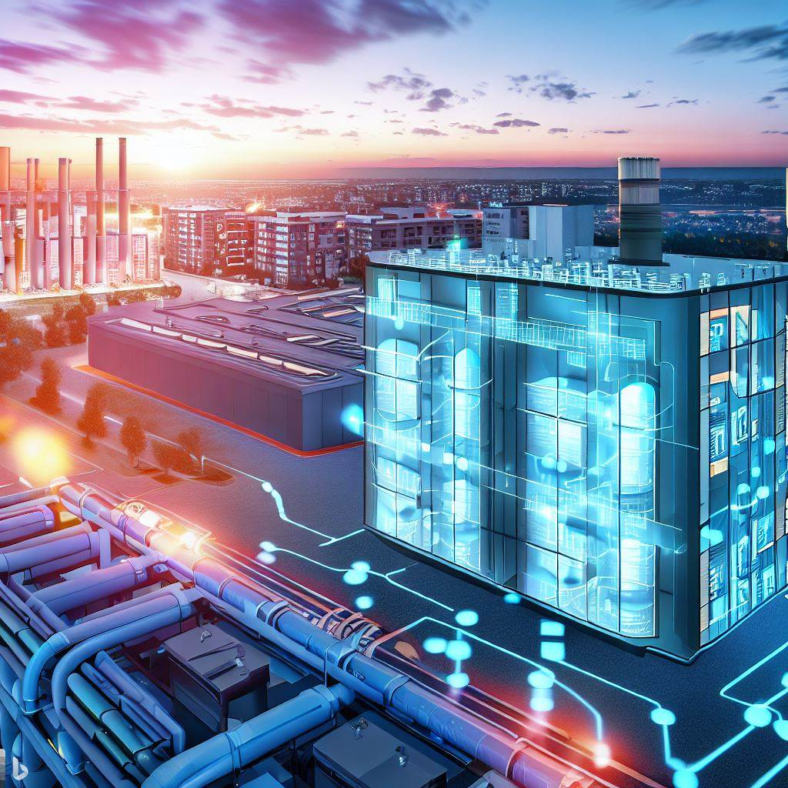
Agenda
Speaker's Prelude
Data Centres: Urban Energy Giants
Data Centres as Prosumers
The Evolution of District Heating
Overview of the 5G District Heating
Conclusion
Discussion and Questions

Slide 3


Speaker’s Prelude
Alireza Etemad
PhD Candidate at UCD – NexSys Project
  Under Supervision of Associate Professor James O’Donnell
Senior Energy Policy Researcher at SEAI
  Decarbonized Heat Group, Research and Technology Department
Alireza.Etemad@ucdconnect.ie

Slide 4
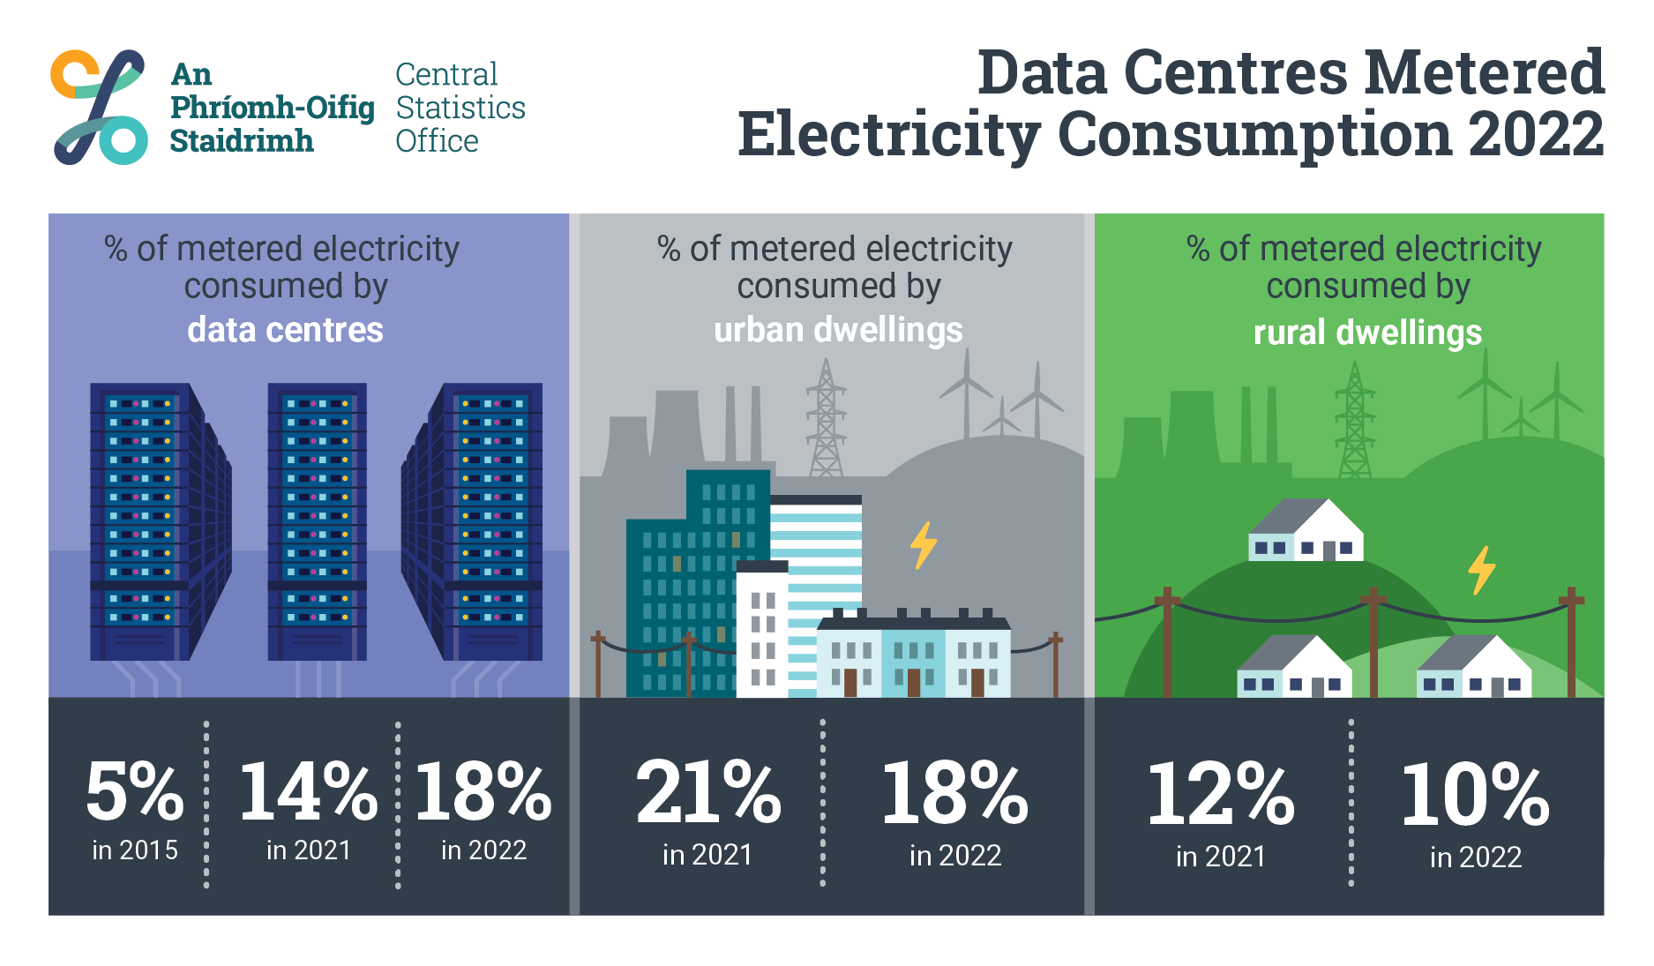
Data Centres: Urban Energy Giants

Slide 5
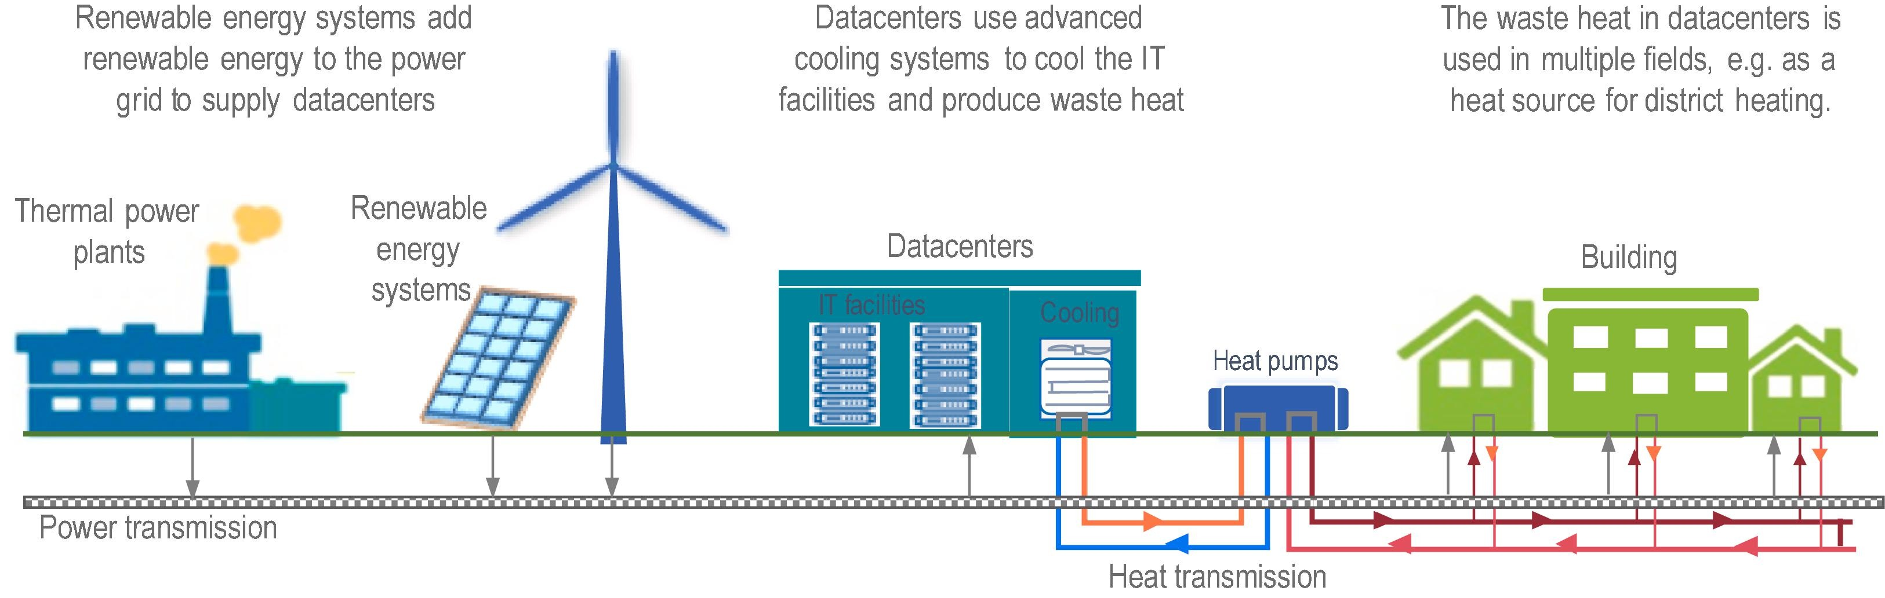
A Potential in Town: Data Centres as Prosumers

Slide 6
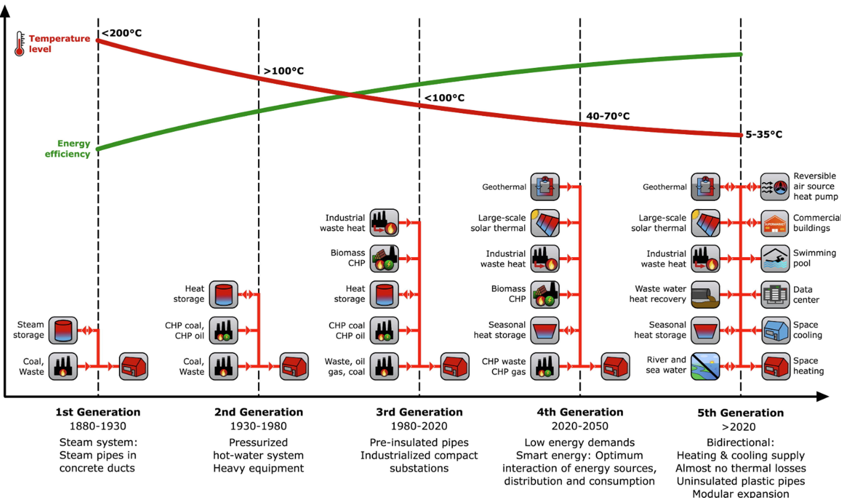
From steam age to smart thermal grids :
The evolution of district heating

Slide 7
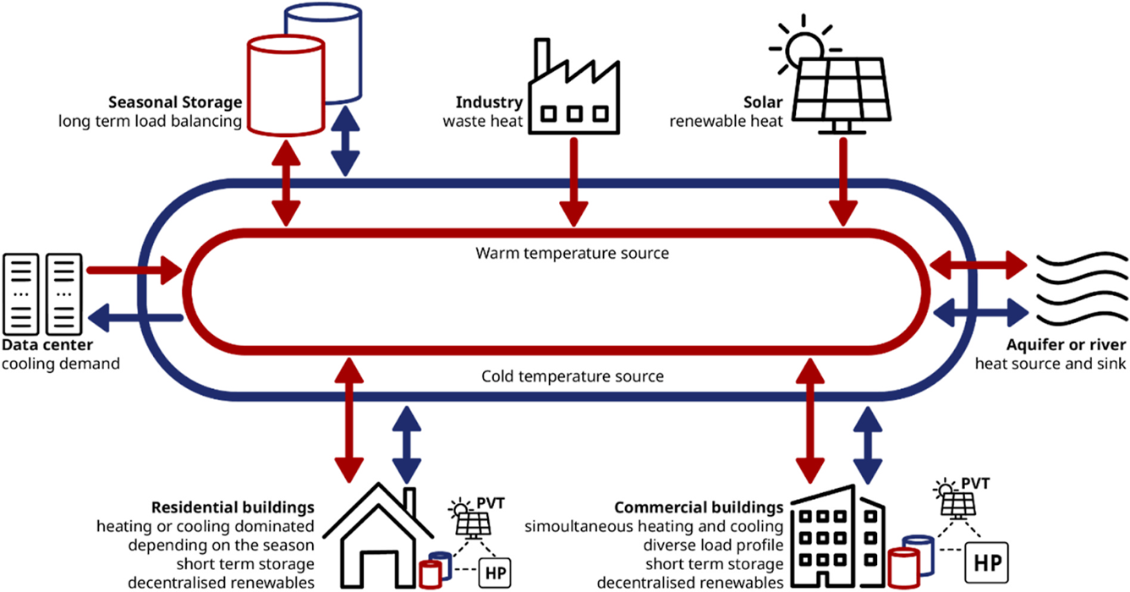
Overview of the 5th Generation District Heating

Slide 8

Wait a minute…What?!
A tricky question may come to mind when people hear about the 5GDHCS:
If in this system, every house should have a Heat pump, then what is the point of district heating?
Are we having a reverse evolution to go back to the individual heating?
Please take a moment to think about the answer…

Slide 9
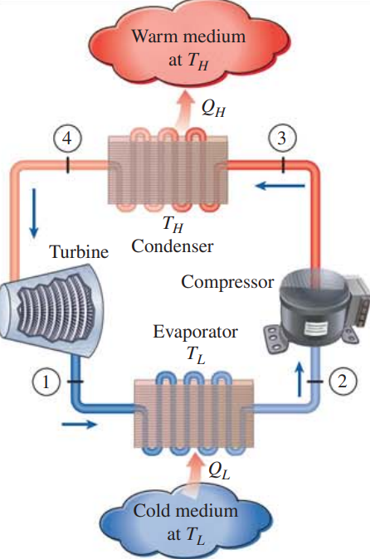

5GDH : A Network of Heat Pumps
Air Source
T_{L} = 0 ºC
Ground Source
T_{L} = 6~10 ºC
Water Source
T_{L} = ??? ºC

Slide 10
5GDH: A Network of Heat Pumps
5GDHC network
Air Source
T_{L} = 0 ºC
Ground Source
T_{L} = 6~10 ºC
Water Source
T_{L} = ??? ºC

Slide 11
SWOT Analysis of 5G Heat Networks
Strengths
Weaknesses
Recovering low-temperature excess heat
Bi-directionality
Modularity, flexibility and resiliency
Almost no pipe insulation needed
More Expensive Substations
Larger pipeline diameter due to Low ΔT
Electricity costs for HPs.
Traditional DH design approach needs to be reviewed.
Higher costs for future HPs due to F-gas phasing out.
In case of seasonal storage need, lack of space.
Opportunities
Threats
New business model for the energy market.
Possibility of upgrading existing high-temp DH system to 5G
Decarbonization target can be achieved
Higher interaction with the electric sector (HPs)

Slide 12
Conclusion
In Dublin, datacenters consume 18% of the total electricity consumption equivalent to 5252 GWh
Around 30-40% of this energy is rejected as heat.
With proper heat recovery technologies, 60-80% of this energy can recovered from the cooling system.
Since this heat is low-grade, it is ideal for low temperature applications like 5GDH .
5G district heating networks offer a great decarbonization opportunity for modern cities.
With a decarbonized electricity grid accompanying 5G district heating, ambitious climate goals are achievable.
There are still serious technical, political and economical challenges in developing this technology !

Slide 13
Questions?

Slide 14

Next Generation Energy Systems

